Slide 1

Beginner’s Workshop
Paul Lammertsma
CTO, Pixplicity

Slide 2
Agenda
10:00 Introduction
10:30 Lesson #1
11:30 Lesson #2
12:30 Lunch
13:30 Lesson #3
14:30 Lesson #4
15:30 Lesson #5
16:30 Homework

Slide 3
Contents
Introduction
Lesson #1 Android Studio & projects
Lesson #2 Activities & Views
Lesson #3 Intents, Tasks & Activity Back Stack
Lesson #4 ListViews & Adapters
Lesson #5 All together now! An image viewing app
Homework

Slide 4
Contents
Assumed knowledge
The Java language and syntax
Basic Object Oriented (OO) programming
Basic event driven programming
Writing tests
Working with more complex concepts
Services, Broadcast Receivers, Databases, etc.
Performing background tasks
Homework!

Slide 5
Why Android?
Truly open! (…truly open?)
Component based
Tons of built-in services
Automatic management of application life cycle
High-quality graphics and sounds
Portability across a wide range of hardware

Slide 6
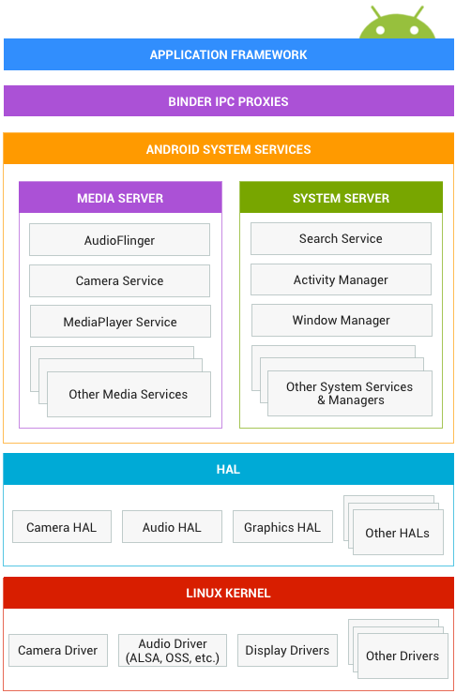
Android System

Slide 7
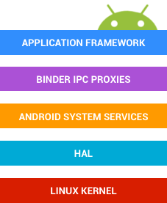
Android System
Your application interacts with the Application Framework.
Some of those frameworks use Inter-Process Communication to cross process boundaries to interact with Android system services.
There are media services, such as Camera and MediaPlayer, and system services, such as ActivityManager and NotificationManager.
These services in turn access the underlying hardware, using the Hardware Abstraction Layer, a standard interface for hardware vendors.
The hardware is ultimately controlled by device drivers based on the Linux kernel.

Slide 8

Android System

Slide 9
Building Blocks
Activities, Views
Intents
Services
Content Providers
Broadcast Receivers
Resources
Safe and Secure

Slide 10
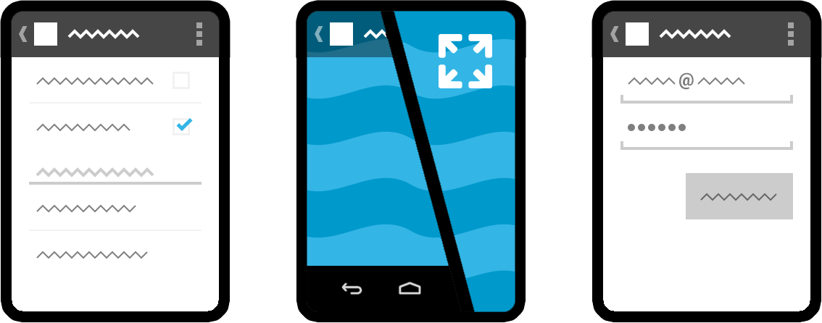
Activity
Single screen with a user interface
Excluding system interfaces (system bar, navigation)
Notes:
An activity represents a single screen with a user interface. For example, an email app might have one activity that shows a list of new emails, another activity to compose an email, and another activity for reading emails. Although the activities work together to form a cohesive user experience in the email app, each one is independent of the others. As such, a different app can start any one of these activities (if the email app allows it). For example, a camera app can start the activity in the email app that composes new mail, in order for the user to share a picture.

Slide 11
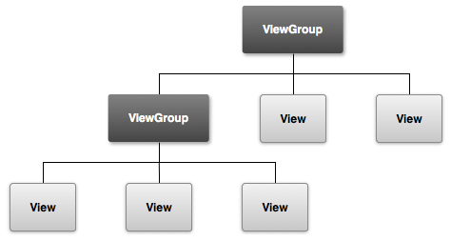
User Interface
Hierarchy of View and ViewGroup objects

Slide 12
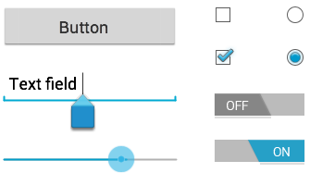
Views / “widgets”
User interface components
Platform native vs. Material/AppCompat

Slide 13
Views / “widgets”
User interface components
Platform native vs. Material/AppCompat

Slide 14
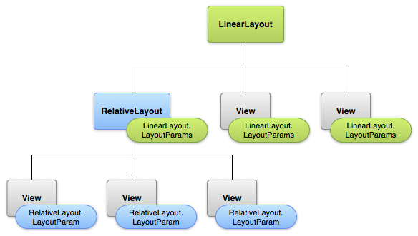
Layouts
Implementation of a user interface

Slide 15



Layouts
LinearLayout
horizontal / vertical layout
RelativeLayout
below, leftOf, alignTop to other views or parent
GridLayout
columns / rows
FrameLayout
single frame / stacked items

Slide 16


Layouts with Adapters
Binds data to a layout dynamically using an Adapter
ListView
scrolling single column list
GridView
scrolling grid of columns and rows

Slide 17
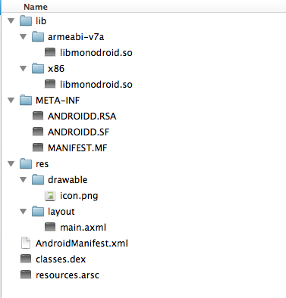
Contents of an APK
Packaged as APK-file (ZIP file)
Manifest
Signing information
Compiled code & resources
Binary resources and assets

Slide 18
Contents of an APK
Native libraries by CPU architecture
Certificate and SHA-1 file digests
Uncompiled resource files
Android’s manifest that describes app
Java classes compiled into dex format
Pre-compiled resources (e.g. binary XML)

Slide 19
AndroidManifest.xml
Application information (version number, version code)
Minimum and target SDK Version
App permissions and device constraints
Activities (with intent filters) <activity>
Services <service>
Broadcast Receivers <receiver>
Content Providers <provider>

Slide 20
Course Guide
Make sure you have the course guide open:
https://pixplicity.gitbooks.io/android-beginners-workshop/
Online
PDF
ePub
Mobi

Slide 21
Legend
Course Guide:
…
…

Slide 22
Rules
Ask questions
Talk to others
Work together
Take breaks

Slide 23
Lesson #1
Android Studio & projects

Slide 24

Android Studio

Slide 25
Getting Started
Course Guide:
Getting Started
Java SDK
Android Studio
Git client (optional)
Ensure everything's up-to-date
Prepare a device

Slide 26
Lesson 1
45
Course Guide:
Lesson 1
Importing an Android project in Android Studio
The Android Project structure
Gradle build files
AndroidManifest.xml
MainActivity
Resources & layouts

Slide 27
Lesson 1
New Project Wizard
Import sample
SDK Manager
Run on emulator
Gradle files
Building with gradlew

Slide 28
Lesson 1
AndroidManifest.xml
Package, permissions, application, activity
MainActivity
onCreate()
setContentView()
Referenced layout
Resource folders
String resources

Slide 29
Show File - New Android Project Wizard
Import sample01 project into Android Studio
Show that a build executes immediately
Once done you can run it on a device, or on an emulator
Show emulator
Show Gradle build files and their contents
Show how to build via the command line with ./gradlew
Open AndroidManifest.xml file and explain its contents
Package (mention it’s not the Java package)
Permissions
Application tag - app name string resource
Activity tag
Launch intent filter (more in lesson 2)
Show how to start the SDK manager from the Tools window
Open MainActivity.java
OnCreate()
setContentView()
Open ./res/layout/activity_main.xml by clicking from method
LinearLayout
attributes - width & height
gravity attribute
Show resource folders and their contents
Show localized app-name in Dutch (create res/values-nl/strings.xml)

Slide 30
Lesson #2
Activities & Views

Slide 31
Activities
Invoked by Intents
Have a lifecycle
Resumed in the foreground & has user focus (“running”)
Paused visible, but another activity has focus
Stopped completely obscured in the background
Can be killed to free up memory
Notes:
If an activity is paused or stopped, the system can drop it from memory either by asking it to finish (calling its finish() method), or simply killing its process. When the activity is opened again (after being finished or killed), it must be created all over.

Slide 32
Activity lifecycle
Resumed The activity is in the foreground of the screen and has user focus. (This state is also sometimes referred to as "running".)
Paused Another activity is in the foreground and has focus, but this one is still visible. That is, another activity is visible on top of this one and that activity is partially transparent or doesn't cover the entire screen. A paused activity is completely alive (the Activity object is retained in memory, it maintains all state and member information, and remains attached to the window manager), but can be killed by the system in extremely low memory situations.
Stopped The activity is completely obscured by another activity (the activity is now in the "background"). A stopped activity is also still alive (the Activity object is retained in memory, it maintains all state and member information, but is not attached to the window manager). However, it is no longer visible to the user and it can be killed by the system when memory is needed elsewhere.

Slide 33
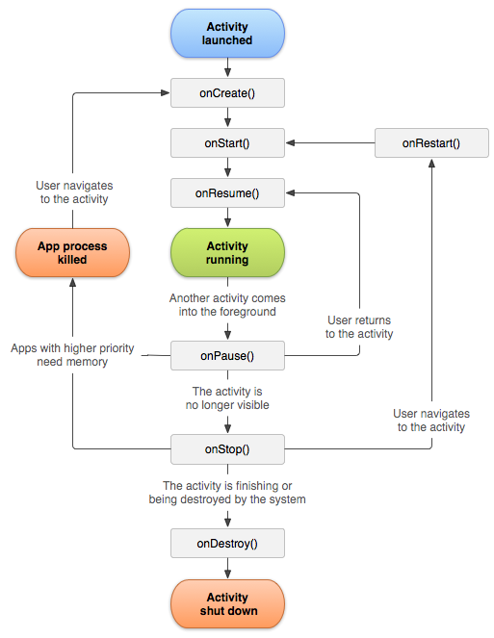
Activity lifecycle

Slide 34
Events & Listeners
button.setOnClickListener( new View.OnClickListener() { public void onClick(View v) { //… } } );

Slide 35
Lesson 2
45
Course Guide:
Lesson 2
Activity launch intent filter
The activity life cycle
Logcat
Click listeners

Slide 36
Lesson 2
AndroidManifest.xml
Activity’s launch intent filter
MainActivity
onCreate(), onResume(), onPause()
Annotations
Logcat

Slide 37
Lesson 2
activity_main.xml
Design, Text and Preview
Add “Person Name” TextView
Add Button
android:id
Referencing layouts from code
Registering an OnClickListener

Slide 38
Lunch!
60

Slide 39
Lesson #3
Intents, Tasks & Activity Back Stack

Slide 40
Intents
Navigate to other Activities
Not just your own Activities
Pass information along
Receive information back
Explicit vs. implicit

Slide 41
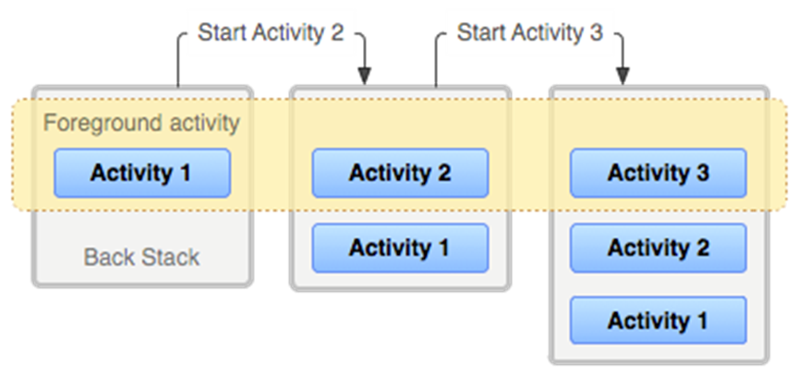
Explicit intents
Launch a very specific component of an app
Activities
Services

Slide 42
Explicit intents
Intent intent = new Intent( ActivityA.this, ActivityB.class);
// (add data to the intent)
startActivity(intent);
Do not create an instance; Android will take care of this for you
You will never need to create instances in this form:
new ActivityB();
Android maintains the lifecycle of your Activities

Slide 43

Implicit intents
By Action
Intent.ACTION_SEND
android.media.action.IMAGE_CAPTURE
By Uri
https://plus.google.com/+PaulLammertsma
By Mime type
"text/plain"
A combination

Slide 44
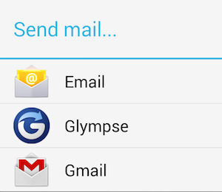
Implicit intents
Intent intent = new Intent( Intent.ACTION_SENDTO, Uri.parse("mailto:paul@pixplicity.com"));
intent.putExtra(Intent.EXTRA_SUBJECT, "Hi there!");
intent.putExtra(Intent.EXTRA_TEXT, "I learned a lot from the workshop!");
startActivity(Intent.createChooser(intent, "Send mail…"));

Slide 45
Tasks & Activity Back Stack
Notes:
“last in, first out”

Slide 46
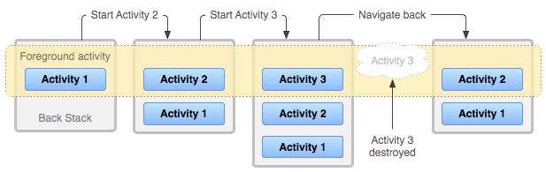
Tasks & Activity Back Stack
Notes:
“last in, first out”

Slide 47
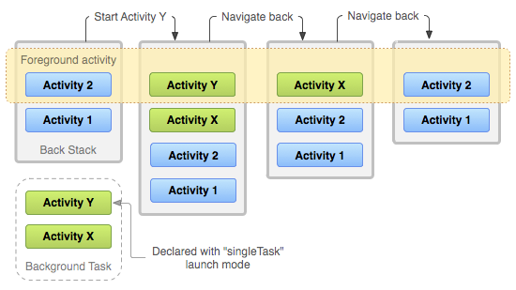
Tasks & Activity Back Stack

Slide 48
Lesson 3
45
Course Guide:
Lesson 3
Explicit intents
Implicit intents
The activity back stack
Exchanging data between activities

Slide 49
Lesson 3
Debugging crashes
Breakpoint in SecondActivity.onCreate()
Retreive email and subject from EditTexts
Create explicit intent to another Activity
Pass along data in Intent extras
Purpose of onSaveInstanceState()

Slide 50
Lesson 3
Implicit intent to send an email
Inspecting the activity stack using adb shell dumpsys activity

Slide 51
Lesson #4
ListViews & Adapters

Slide 52
ListViews & Adapters
ListView Component to display a (long) list of scrollable things
Adapter Pulls content from a source
E.g. an array or database query
Each item shows as a View in the list

Slide 53
RecyclerView
Homework!
More advanced and flexible than ListView
For instance, animations!
Still easy to use
From the support library
Sorry! Won’t be covered in this workshop compile 'com.android.support:recyclerview-v7:23.0.+'

Slide 54
Adapter contract
int getCount();
How many items are in the data set represented by this Adapter
Object getItem(int position);
Get the data item associated with the specified position in the data set
long getItemId(int position);
Get the row id associated with the specified position in the list
View getView(int position, View convertView, ViewGroup parent);
Return a view for the given position, given a recycled convertView

Slide 55
Lesson 4
45
Course Guide:
Lesson 4
ListViews
RecyclerViews
Adapters

Slide 56
Lesson 4
ListView & RecyclerView are efficient for large data sets
Grasping the concept of Adapters
Array resources
Creating ArrayAdapters
Hierarchy of types
ListView & ListActivity
onListItemClicked()
Notes:
Show hierarchy of ArrayAdapter in Android Studio

Slide 57
Lesson 4
04.01
public class ListViewInLayoutActivity extends Activity {
private ListView listView;
@Override
protected void onCreate(Bundle savedInstanceState) {
super.onCreate(savedInstanceState);
setContentView(R.layout.activity_listview_in_layout);
listView = (ListView) findViewById(R.id.listview);
String[] entries = getResources().getStringArray(R.array.animals);
ArrayAdapter<String> arrayAdapter = new ArrayAdapter<String>( this, android.R.layout.simple_list_item_1, entries);
listView.setAdapter(arrayAdapter);
}
}
Notes:
Solutions:
04.01: https://gist.github.com/dutchaug/9942397
04.02: https://gist.github.com/dutchaug/9942560
04.03: https://gist.github.com/dutchaug/9942707

Slide 58
Lesson 4
04.02
public class ListViewActivity extends ListActivity {
@Override
protected void onCreate(Bundle savedInstanceState) {
super.onCreate(savedInstanceState);
String[] entries = getResources().getStringArray(R.array.animals);
ArrayAdapter<String> arrayAdapter = new ArrayAdapter<String>( this, android.R.layout.simple_list_item_1, entries);
getListView().setAdapter(arrayAdapter);
}
}
Notes:
Solutions:
04.01: https://gist.github.com/dutchaug/9942397
04.02: https://gist.github.com/dutchaug/9942560
04.03: https://gist.github.com/dutchaug/9942707

Slide 59
Lesson 4
Custom adapters
CustomAdapter extends BaseAdapter
Android Studio’s auto-completion
Using the LayoutInflater
Notes:
Alt+Enter to auto-generate missing interface methods in Android Studio

Slide 60
Lesson 4
04.03
public class CustomAdapter extends BaseAdapter {
private final Context mContext;
private final List<Animal> mData = new ArrayList<Animal>();
public CustomAdapter(Context context) {
mContext = context;
mData.add(new Animal( "Bear", "Mammal", R.drawable.bear_thumb, R.drawable.bear, "http://a-z-animals.com/animals/bear/"));
…
}
Notes:
Solutions:
04.01: https://gist.github.com/dutchaug/9942397
04.02: https://gist.github.com/dutchaug/9942560
04.03: https://gist.github.com/dutchaug/9942707

Slide 61
Lesson 4
04.03
@Override
public int getCount() {
return mData.size();
}
@Override
public Object getItem(int position) {
return mData.get(position);
}
@Override
public long getItemId(int position) {
return position;
}
Notes:
Solutions:
04.01: https://gist.github.com/dutchaug/9942397
04.02: https://gist.github.com/dutchaug/9942560
04.03: https://gist.github.com/dutchaug/9942707

Slide 62
Lesson 4
04.03
@Override
public View getView(int position, View convertView, ViewGroup parent) {
Animal animal = mData.get(position);
if (convertView == null) {
LayoutInflater layoutInflater = (LayoutInflater) mContext.getSystemService(Context.LAYOUT_INFLATER_SERVICE);
// If you have created your own custom layout you can replace it here
convertView = layoutInflater.inflate(R.layout.custom_layout, null, false);
}
ImageView imageView = …
TextView textView = …
return convertView;
}
Notes:
Solutions:
04.01: https://gist.github.com/dutchaug/9942397
04.02: https://gist.github.com/dutchaug/9942560
04.03: https://gist.github.com/dutchaug/9942707

Slide 63
Lesson 4
04.03
public class CustomAdapterActivity extends ListActivity {
private CustomAdapter mCustomAdapter;
@Override
protected void onCreate(Bundle savedInstanceState) {
super.onCreate(savedInstanceState);
mCustomAdapter = new CustomAdapter(this);
getListView().setAdapter(mCustomAdapter);
}
Notes:
Solutions:
04.01: https://gist.github.com/dutchaug/9942397
04.02: https://gist.github.com/dutchaug/9942560
04.03: https://gist.github.com/dutchaug/9942707

Slide 64
Lesson 4
04.03
@Override
protected void onListItemClick(ListView l, View v, int position, long id) {
Animal animal = (Animal) mCustomAdapter.getItem(position);
Uri uri = Uri.parse(animal.infoUrl);
Intent intent = new Intent(Intent.ACTION_VIEW, uri);
startActivity(intent);
}
Notes:
Solutions:
04.01: https://gist.github.com/dutchaug/9942397
04.02: https://gist.github.com/dutchaug/9942560
04.03: https://gist.github.com/dutchaug/9942707

Slide 65
Lesson #5
All together now! An image viewing app

Slide 66
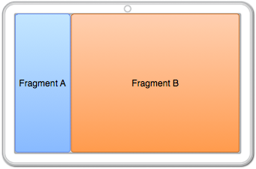
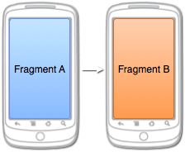
Reusing fragments
Action starts Activity B
Action updates Fragment B
Activity A contains Fragment A
Activity B contains Fragment B
Activity contains Fragment A & B

Slide 67
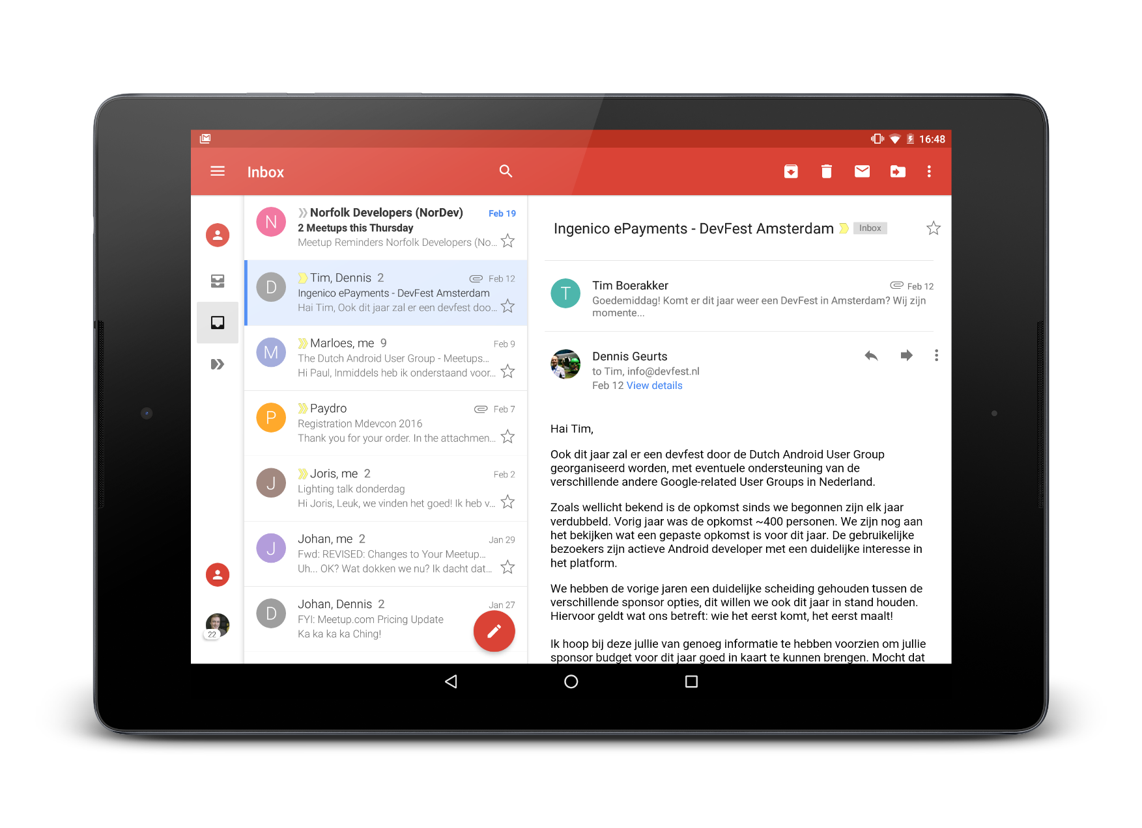
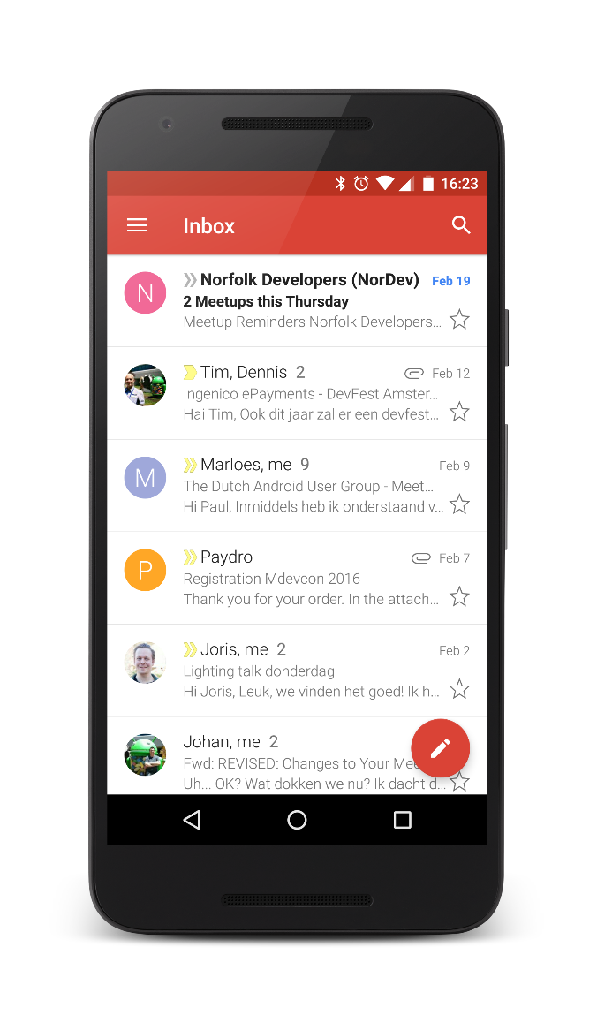
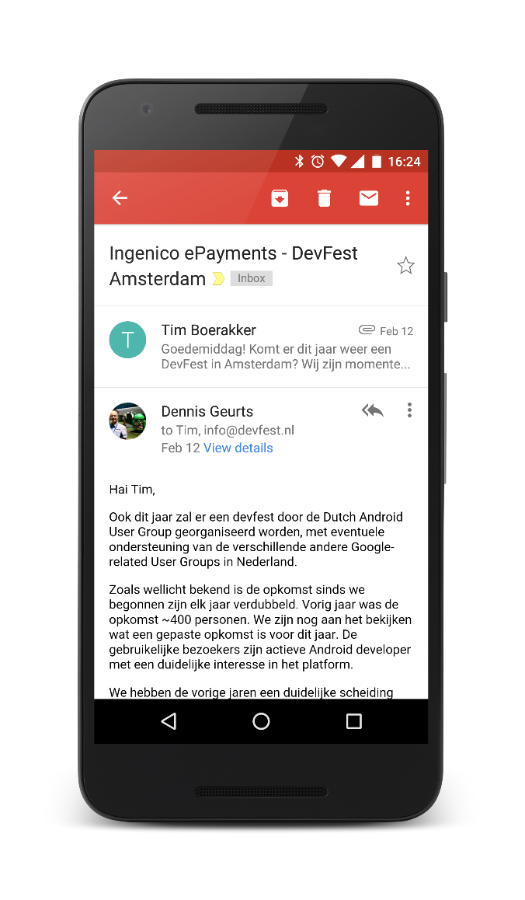
Reusing fragments

Slide 68
Fragments
Reusable & modular
Have their own lifecycle
Interactions go through the FragmentManager
activity.getFragmentManager()
Can be added to a layout through
XML, as <fragment>, or
Code, using FragmentTransactions

Slide 69
ViewPager

Slide 70
ViewPager
Similar to a ListView:
Adapter provides the data
In theory, unlimited contents
Items can be Views or Fragments
For fragments, use a matching adapter:
FragmentPagerAdapter
FragmentStatePagerAdapter

Slide 71
Lesson 5
45
Course Guide:
Lesson 5
ViewPager
Fragments
MediaPlayer

Slide 72
Lesson 5
Fragments and ViewPagers
The support package
Create AnimalFragment
Implement AnimalPagerAdapter
Notes:
AnimalFragment:
ARG_IMAGE_RESOURCE
field int imageResource
public static AnimalFragment newInstance(Animal animal)
onCreate getArguments
onSaveInstanceState
onCreateView inflate fragment_image, cast to ImageView and set imageView resource to imageResource int

Slide 73
Homework
Basic event driven programming
Writing tests
Working with more complex concepts
Services, Broadcast Receivers, Databases, etc.
Performing background tasks

Slide 74
Beginner’s Workshop
Paul Lammertsma
CTO, Pixplicity

